Slide 1
An Industrial Internet of Things (IIOT) With an Underlying Clustered 5G HetNet
Dr Naureen Farhan

Slide 2
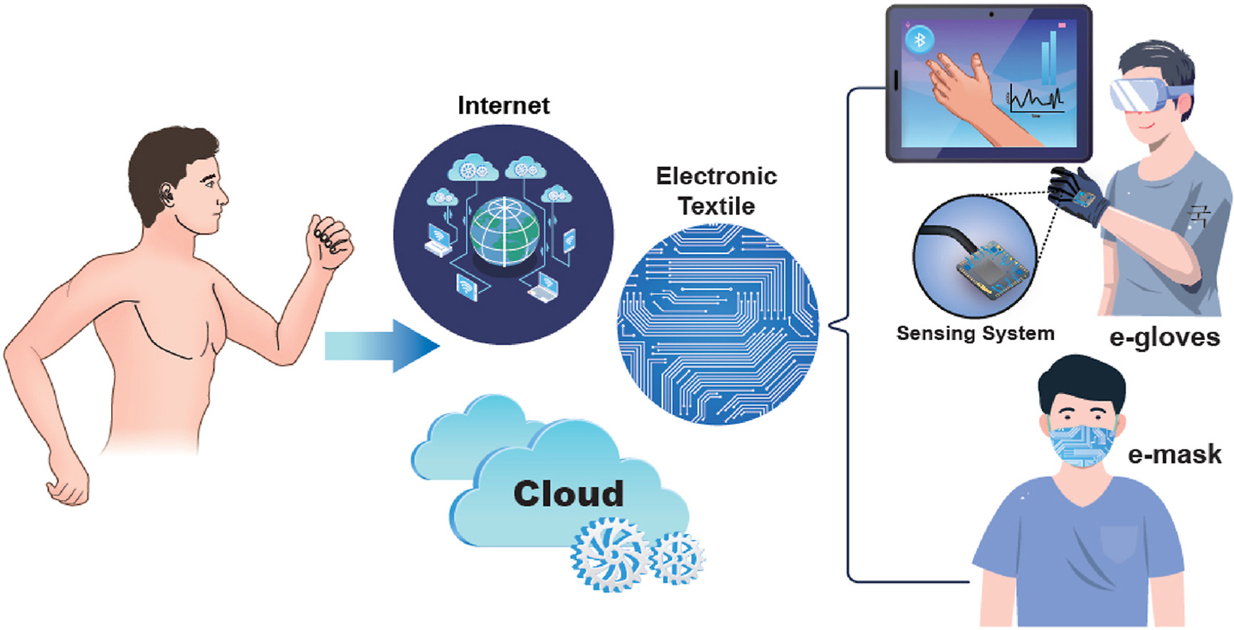
Wearables for Smart Manufacturing in Industry 4.0
Wearable IoTs are used to optimize human tasks to meet the new age industry requirements.
To manage:
Resource efficiency
Safety
Accuracy
Delay
New age of Wearable Technology
Source: Devi DH, Duraisamy K, Armghan A, Alsharari M, Aliqab K, Sorathiya V, Das S, Rashid N. 5G Technology in Healthcare and Wearable Devices: A Review. Sensors. 2023; 23(5):2519. https://doi.org/10.3390/s23052519
Notes:
fgfgfghf

Slide 3
5G Heterogeneous Networks
Massive Connectivity in IOT
Ultra High Reliability
Reduced Latency
Increased Overall Throughput
Increase profit margin
Increase production
Automate business
High Throughput
Enhanced Capacity
Reduced Latency
IOT with 5G Heterogeneous Network
5G Network Architecture

Slide 4
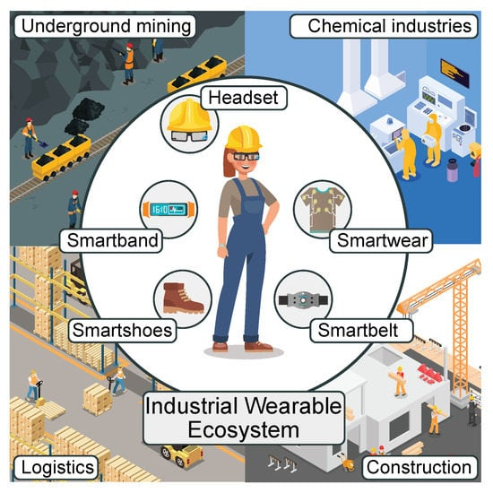
Industry 4.0 - Wearable IoTs
Adaptable manufacturing system to changing demands.
Custom products to meet customer needs.
Manufacturers can detect defects early.
Ensure improved product quality.
Svertoka, E., Saafi, S., Rusu-Casandra, A., Burget, R., Marghescu, I., Hosek, J. and Ometov, A., 2021. Wearables for industrial work safety: A survey. Sensors, 21(11), p.3844.

Slide 5
Challenges of Wearable IoT
Challenges from existing researches
Increased accidental occurrences, safety and health issues of the workers Further challenges include Energy efficiency, Communication, Capacity, Latency, Throughput, Reliability, Availability Wearable systems enable: Remote Control Real time monitoring via Augmented Reality Sensor Data Aggregation Wireless Networking
Industrial wearable systems and augmented reality holds the requirement for: Reduced Latency – Medium Efficient Bandwidth – High Wireless Communication – Essential

Slide 6
Table 01: IIOT Challenges
Access Technology | Predicted connected devices | Usage | Performance Constraint | Coverage Constraint
High Power Wireless Access (HPWA) | +2 Billion | Driverless cars, video surveillance, etc. | High | High/Moderate
Low Power Wireless Access (LPWA) | +11Billion | Sensors, utility meters etc. | Moderate | High

Slide 7
Table 02: Comparative analysis of various approaches applied for Resource Management in 5G.
Technique / Approach | Complexity | Cross Tier Interference | Co Tier Interference | Load Balancing | QoS | Spectral Efficiency
Distributed Learning | Moderate | High | Low | Moderate | Low | Moderate
Frequency Reuse | Moderate | High | High | Low | Low | High
Graph Theory | Moderate | High | High | Low | Low | Moderate
Power Minimization | Moderate | Low | High | Moderate | Moderate | High
Cognitive Radio | High | High | Moderate | Moderate | Low | Moderate
Clustering | Moderate | Moderate | Moderate | Moderate | Moderate | High

Slide 8
Significance of Clustering in 5G HetNet
Increased Capacity in IIOT Networks
Reduced Cell Size (SBS)
Enhanced Signal Processing
Reduced Interference
Increase capacity
Fair load distribution
Efficient management of IOT devices can be achieved with the n-tier network architecture.
Techniques to improve the Capacity in IIOT Environments

Slide 9
Proposed Hybrid Clustering Scheme
Small Cell Gateway - SGW
Hybrid Clustering
5G HetNet
Random deployment of SBSs - PPP
All SBSs broadcast their Tx to the SGW. Based on distance VQ performed
SGW Received power will be compared with the ‘τ’threshold value
SBSs selected as HSBS
Centralized clusters will be formed
SBSs selected as LSBS
Distributed clusters will be formed
Cooperative PD – NOMA clusters will be formed based on CSI from all users connected to the SBSs in the network.
Increased Coverage and Capacity
Reduced Interference
Increased Throughput
Workflow of the Proposed Scheme

Slide 10
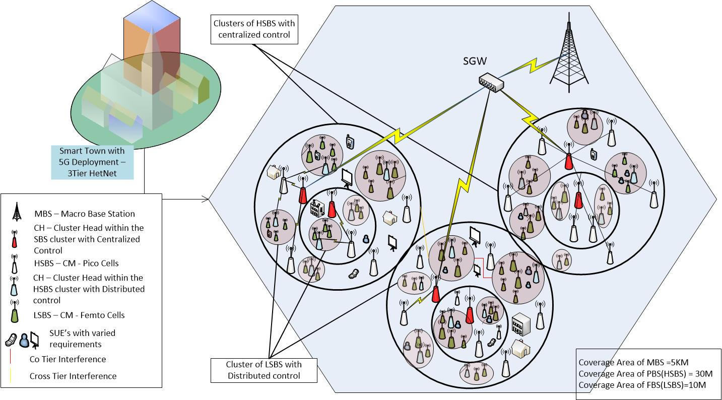
5G Interference Managed Hybrid Clustering
A 5G HetNet Architecture after Implementing the Hybrid Clustering Scheme

Slide 11
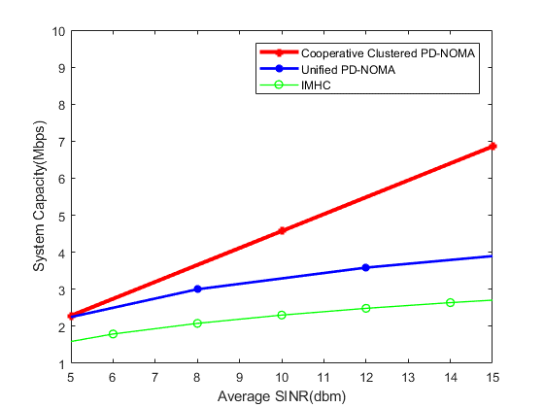
Result and Analysis
Improved by 80%
Improved by 8%
System Capacity achieved with the proposed hybrid clustering approach is improved by 8% compared to the unified PDNOMA scheme, and more than 80% compared to the IMHC scheme.

Slide 12
Result and Analysis
End to End delay achieved with different schemes with increased number of devices.

Slide 13
Result and Analysis
Throughput achieved with increased number of devices.

Slide 14
Summary
Table 03: Summary of Improved Throughput achieved with the IMHC Scheme
Improved Throughput achieved with IMHC Scheme | Hybrid | Distributed | Centralized
 | 6% | 10% | 11%
Table 04: Summary of Improved results with the Cooperative Clustered PD-NOMA
Improved parameters achieved with Cooperative PD-NOMA | Unified PD-NOMA | IMHC (OFDMA Scheme)
System Capacity | 8% | 80%
Sum Rate | 4% | 14%
Throughput | 23% | 65%

Slide 15
Conclusion
With the proposed technique the interference has been reduced to a significant level and high throughput, and capacity is achieved with lowered end-to-end delay in a 5G IoT environment.
These contributions not only transform manufacturing practices, but also empower creative industry professionals to further enhance innovation and design in exceptional ways.

Slide 16
References
M. Alfaqawi, S. Baron, V. Pitard, S. Davai and N. Banoun, "Performance Evaluation of 5G Use Cases for Smart Factory," 2022 International Conference on Smart Applications, Communications and Networking (SmartNets), Palapye, Botswana, 2022, pp. 01-06, doi: 10.1109/SmartNets55823.2022.9994009.
Nguyen, T., Tran, K.D., Raza, A., Nguyen, QT., Bui, H.M., Tran, K.P. (2023). Wearable Technology for Smart Manufacturing in Industry 5.0. In: Tran, K.P. (eds) Artificial Intelligence for Smart Manufacturing. Springer Series in Reliability Engineering. Springer, Cham. https://doi.org/10.1007/978-3-031-30510-8_11
Dr. Naureen Farhan, Dr. Safdar Rizvi, and Ms. Aisha Danish. (2024). Presentation on “An Industrial Internet of Things (IIOT) With an Underlying Clustered 5G HetNet”. WACADEMIC_02_26_89620. International Conference on Engineering & Technology, Computer, Basic & Applied Sciences (ICETCBAS-24) 18th - 19th March 2024 | London, UK
Farhan, Naureen, and Safdar Rizvi. "An interference-managed hybrid clustering algorithm to improve system throughput." Sensors 22.4 (2022): 1598.
Hasan, Naureen, Safdar Rizvi, and Amna Shabbir. "A clustered pd-noma in an ultra-dense heterogeneous network with improved system capacity and throughput." Applied Sciences 12.10 (2022): 5206.
Ferreira, J.J., Fernandes, C.I., Rammal, H.G. and Veiga, P.M., 2021. Wearable technology and consumer interaction: A systematic review and research agenda. Computers in human behavior, 118, p.106710.
Seçkin, A.Ç., Ateş, B. and Seçkin, M., 2023. Review on Wearable Technology in sports: Concepts, Challenges and opportunities. Applied Sciences, 13(18), p.10399.

Slide 17
Thank You

